Slide 1
Your University of Nottingham Offer
Strategic Pathways Team,
University of Nottingham

Slide 2
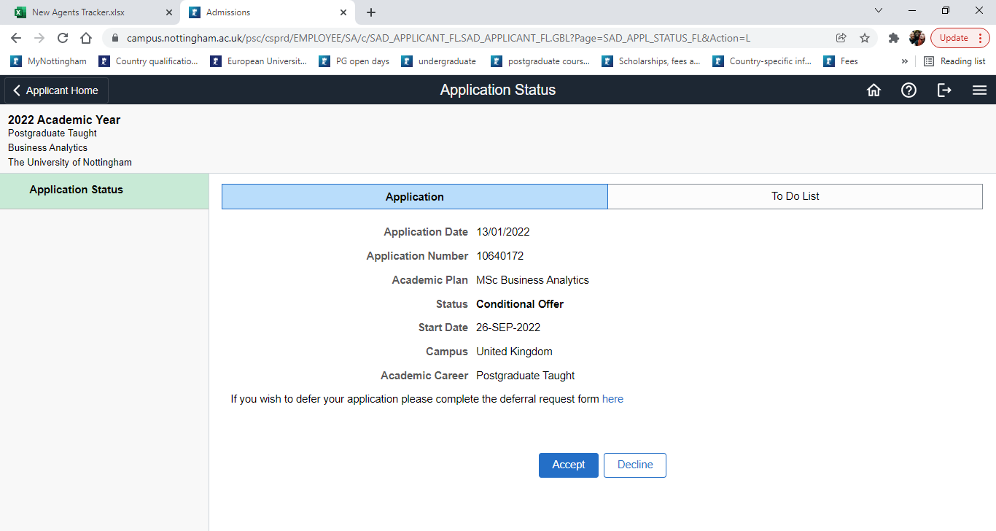
What is an offer?
An offer is what the University uses to give you a place on your chosen course.
Your offer must be accepted on the Nottingham Hub.
You have 6 weeks to accept your offer from when it is issued.
Some courses will not yet have an offer.
Offers can be conditional or unconditional. Conditional offers will become unconditional when the University receives your results.
Notes:
Six week deadline is designed for your benefit, it enables you to receive all offer holder comms related to xxxxx
Some courses e.g. pharmacy / architecture will require an additional stage, e.g. an interview or portfolio

Slide 3
Receiving and accessing your offer... ...and creating your password

Slide 4
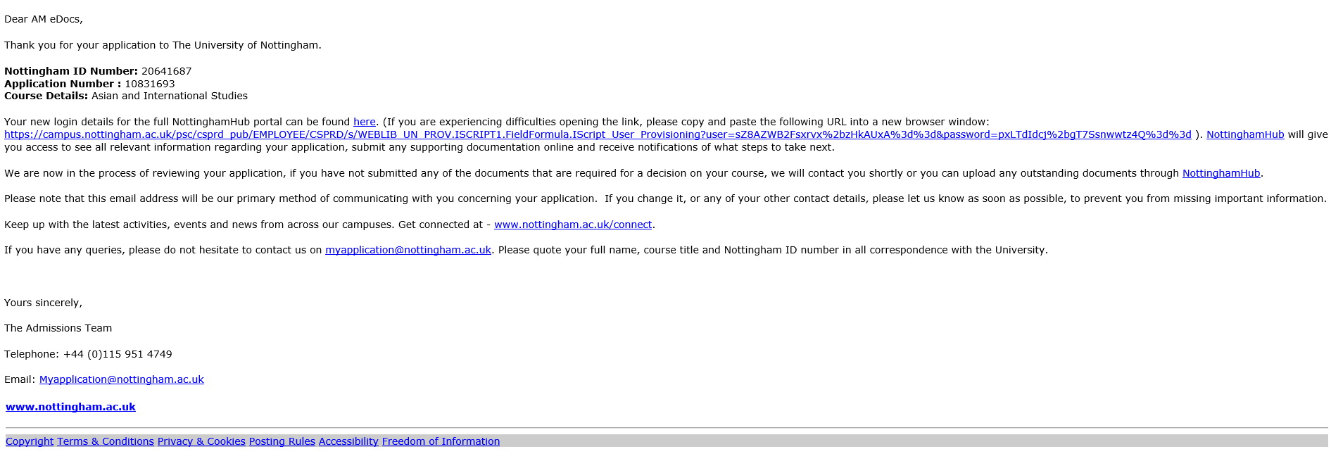
Your offer email from myapplication@nottingham.ac.uk

Slide 5
Click the link next to the red arrow

Slide 6
Note: you must paste the link with no space at the end to be able to access the correct page

Slide 7
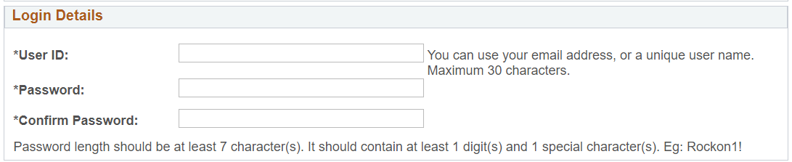
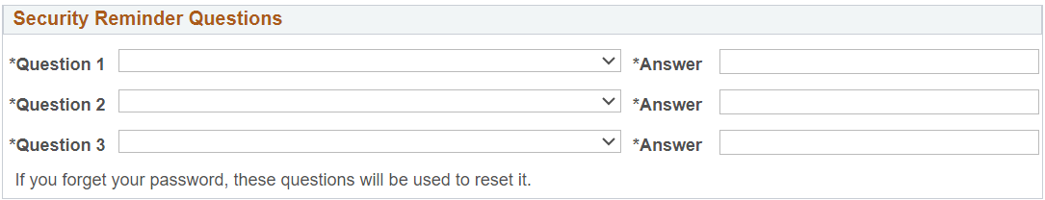
The correct page for setting a password looks like this

Slide 8
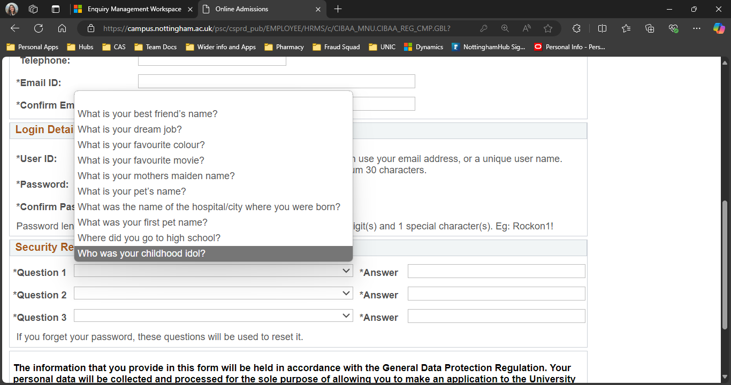
The correct page for setting a password looks like this

Slide 9

How do I set my password?
Use the Nottingham ID number provided in your email from myapplication@nottingham.ac.uk (your Nottingham ID always begins with a '20...').
Then create a password and set security questions you will remember!
You will then be able to log on and access your offer.

Slide 10
What does NottinghamHub look like?

Slide 11
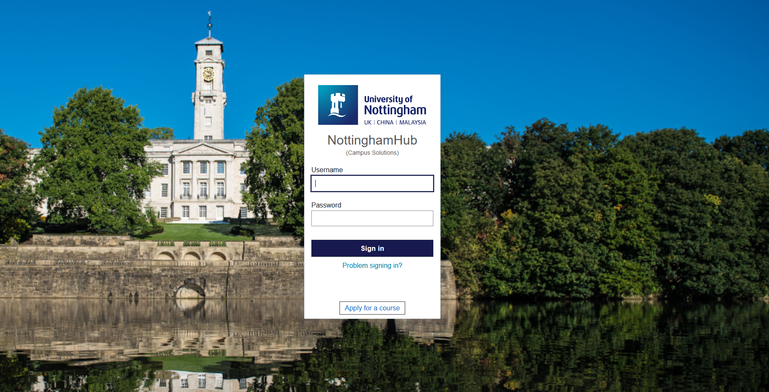
Login page (campus.nottingham.ac.uk)
In the username box, please input your Nottingham ID

Slide 12
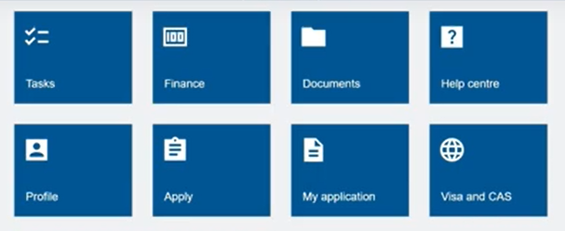

Home screen and offer screen
The first image is the home screen once you have logged in.
If you select the My Application button, you will be taken to your offer where you need to select accept (second image).

Slide 13

Accepting your offer
Review your offer and press accept and you will have completed the process!
REMEMBER: Your Offer will be conditional to start off with. Conditional offers will become unconditional when the University receives your results.
If you do not yet have an offer, your status will read “information escalated”.
Please do not worry if you don’t yet have an offer, this may mean your course might require additional stages, e.g. an interview or a portfolio.

Slide 14
Important things to remember

Slide 15

Remember...
You do not need to make your own application.
You only need to accept your offer once.
Accepting your offer allows your application to move forward.
If you have deposits on your checklist, these will be removed.
You will have 6 weeks from when you receive your offer to accept it!
Your offer will become unconditional when you achieve the grades required in your exams to progress.
Results Day

Slide 16
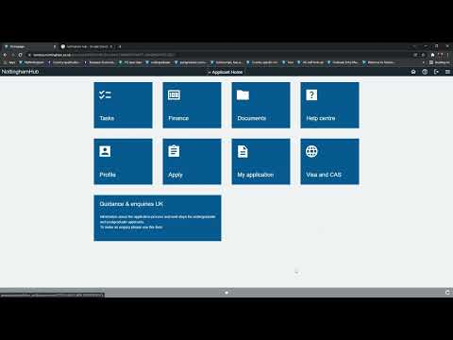
Video guide

Slide 17
Our email: sponsorship-assistant@nottingham.ac.uk
Notes:
If you have any issues with the process of accepting your offer, we will run another presentation and a workshop at the College in January.
Our contact details in the meantime are sponsorship-assistant@nottingham.ac.uk.

