Slide 1

Note taking
Digital Pathways College

Slide 2
Why should you take notes?
“The faintest pencil is better than the strongest memory.”
Greg McKeown.

Slide 3
Why Note Taking is Important?
Note-taking can act as a useful source of reference following a session. Taking notes can remind you of the key points that were covered during a session with your peers and your Tutor.
Notes can also be referred to later in the future. Because the notes have been taken by you, they make learning more meaningful. Finally, your notes can increase your knowledge and understanding about a topic. There are different ways to take notes but remember that if the approach you are using is working for you- do not change it.

Slide 4

When you are taking notes, consider the following:
What do you want to get out of the notes?
How will they help you with your coursework?
Do they make sense?
Have you highlighted the key themes/points?
Are there points that you do not understand fully?

Slide 5
Note taking hints and tips
Use an A4 pad but shorthand pads have their benefits.
Allow for space and comments in the margins.
Write on every other line in your pad.
Try not to write everything down.
Use abbreviations, 1stly, 2ndly.
Mark any points that you disagree with or need clarifying.

Slide 6
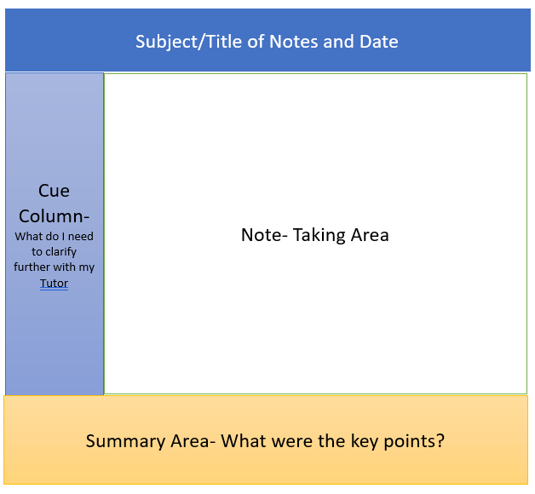
The Cornwell system of taking notes

Slide 7
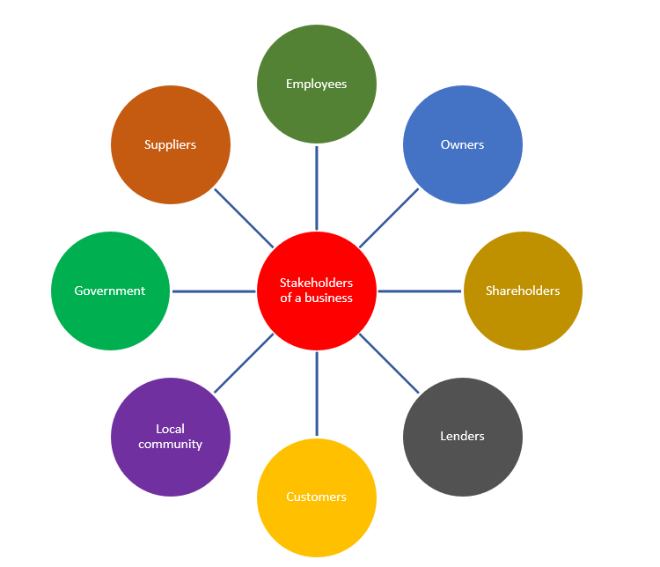
Mind maps
Mind maps are a form of note taking that involves taking less notes and using more visual diagrams to help you remember information for longer periods of time. The latter is referred to as deep learning.
The subject will be the centre of the diagram which serves as a reminder about the topic.
Key words or short phrases are connected to the centre using adjoining lines or arrows. Figure 1 is an example which enables a learner to identify some of the stakeholders of an organisation .
Figure 1- Stakeholders of an organisation

Slide 8
Remember however……….
Avoid writing word for word- impossible to do!
Leave space to add extra points.
Use abbreviations, symbols etc.
Include headings/sub-headings.
Use highlighters for key points.
Above all, if your current system works, keep using this

Slide 9
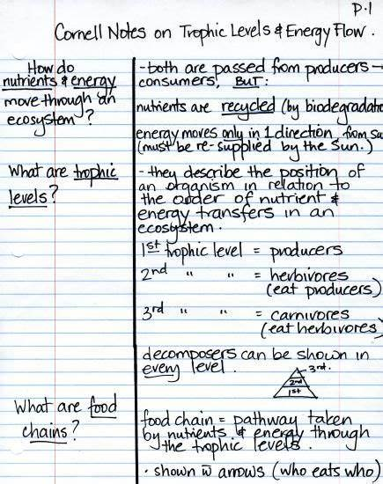

Slide 10
What have been your lightbulb moment?
What have you learnt the most?

Slide 11
THANK YOU FOR JOINING TODAY.

