Slide 1
PM600
Research Project
Theme 7: Ethics
Lesson 2: Research Ethics

Slide 2
Introduction
This PowerPoint will build on some of the ideas introduced in the previous session:
  Defining research ethics
  Identifying relevant ethical codes and guidelines
  Explaining and exemplifying four key ethical principles

Slide 3

Research ethics
Notes:
Define ethics and more particular research ethics. Also discuss scope of research ethics – the different stages at which ethical considerations apply AND the scope of responsibilities researchers have

Slide 4

Do you buy the jeans?
Or do you boycott the brand?
Discuss with your group
What is the right thing to do?
What would YOU do?
  You have seen a pair of jeans you would love to buy and wear
  But the brand has recently been criticised for its use of sweat shops and has now been accused of exploiting child labour
Notes:
Consider the ethical decision to be made: buying goods produced by unethical means (using sweat shops and child labour).
Sweat shop: a factory or workshop, for example in the clothing industry, where workers are employed (with no security) for long hours, with low wages and subject to demanding/poor working conditions.
Child labour: around 200 million children work; widespread throughout Africa, Asia, Latin America and the Caribbean.
There will be different responses. As we shall see decisions about ethics will be shaped by a individual’s unique moral compass, based on their beliefs and perceptions, culture and religion amongst other factors.

Slide 5

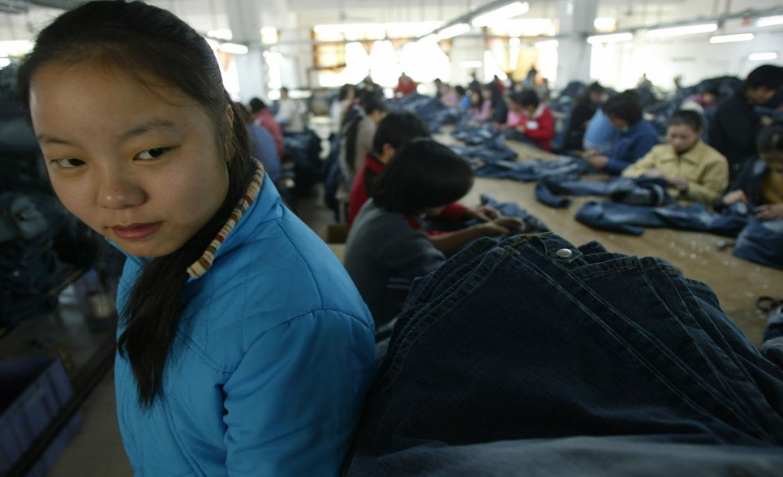
Right, wrong or dilemma?
If you boycott the brand, you contribute to the eradication of unfair child labour.
BUT the child may not be able to feed herself – and may be forced into even more desperate circumstances.
Notes:
Ethical decisions appear to concern simple choices about what is right and what is wrong.
Is this a clear cut decision. Child labour is wrong, therefore the only decision is to boycott the brand.
However, ethical choices frequently present dilemmas.
There are few absolute ethical rules.
Ethical dilemmas concern situations wherein ethical obligations conflict in such a way that any possible resolution to the dilemma is morally intolerable. In other words, an ethical dilemma is any situation in which guiding moral principles cannot determine which course of action is right or wrong.

Slide 6
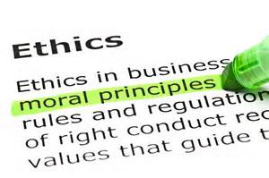

What are ethics?
Ethics represent the moral principles, values and rules that govern our decisions and actions with respect to what is right and wrong, good or bad.
Thus, ethics concern choices, decisions and sometimes dilemmas.
Notes:
At its most basic, ethics concerns decisions about what is right and what is wrong.
Ethics represent systems of moral principles. These moral principles guide how individuals make choices and lead their lives.
Ethics is concerned with what is best for individuals and society, the language of right and wrong, good and bad.

Slide 7
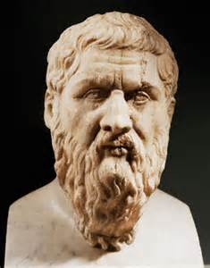
“We are discussing no small matter, but how we ought to live.”
Socrates from Plato’s Republic, Book 1: 352d

Slide 8

Ethics and concern for ‘other’
Ethics focus on ‘others’ including individuals, groups as well as the wider interests of society
Ethical choices, decisions and dilemmas involve considering those beyond ourselves
Do you buy the jeans? How will your choice impact child labourers, employers, Governments, societies?
Discuss
Notes:
Ethics is about the 'other'
Ethics is concerned with other people. At the heart of ethics is a concern about something or someone other than ourselves and our own desires and self-interest.
When a person thinks ethically, at least some thought is given to those beyond themselves.

Slide 9
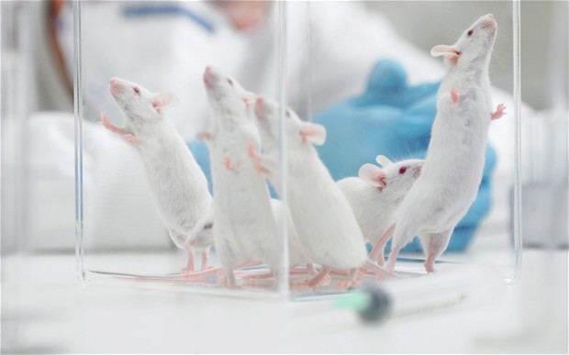
What about research ethics?
Research ethics concern:
the values, rules and guidelines that govern decisions and actions with respect to moral and immoral research practices
the choices and decisions that researchers need to take and the dilemmas they can sometimes face
Research ethics focus on concern for others:
Respect for and care of individuals and groups
Justice in social life
Integrity of discipline and practice
Notes:
Respect for and care of respondents: Humans subjects often used in interviews and focus groups, surveys and questionnaires, observations, audio and video taping, experimental procedures. Not causing participants physical, material or emotional harm
Justice: Not presenting bias; highlighting inequality/unfairness. Research can transform society. Because research has a profound influence on society, researchers cannot ignore the consequences of their discoveries and claims for knowledge.
Integrity: Ethical issues are directly related to the integrity of a piece of research and of the discipline involved. Contributing to knowledge, pursuit of understanding; honesty; appropriate use of research methods

Slide 10
The scope of research ethics
Ethical issues arise at a variety of stages in research
Clarifying your topic
Research design
Data collection
Data analysis
Reporting your findings

Slide 11
Scope of responsibilities
Participants
Funders
Institution
Profession and fellow researchers
Stakeholders
Wider society
Yourself
Notes:
Participants: not to harm or deceive; to respect and care for them
Funders: provide good quality research on time, on budget, use resources efficiently BUT resist influence of outcomes
Institution: integrity of reputation
Profession/fellow researchers: follow appropriate codes of conduct, making it possible for others to continue researching in future
Stakeholders: those with an interest or stake in your research for example minorities/disadvantaged groups or those who may benefit
Wider society: increasing understanding and the development of society
Yourself: not to take unreasonable risks

Slide 12
Codes of ethics
Institutions and professional bodies involved in research will have their own policies and guidelines to which researchers have to adhere
Researchers have to submit their work to ethics committees in order for their work to be sanctioned
  Follow the links on the next slide to view examples of codes of ethical conduct
  Consider VLE forum task

Slide 13
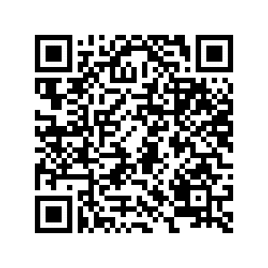
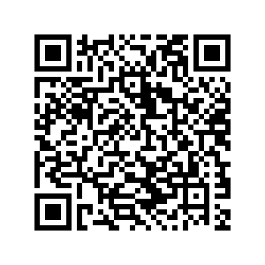
Codes of ethical conduct
Academy of Management (AOM), Code of Ethics
British Education Research Association (BERA), Ethical Guidelines for Educational Research
British Sociological Association (BSA), Statement for Ethical Practice
Notes:
Questions about ethics in business and management research bring in the role of professional associations such as the American Academy of Management. These professional associations have formulated codes of ethics on behalf of their members. It is also useful to look at the way that researchers within the social sciences more generally have dealt with ethical research issues, for example the British Education Research Association and the British Sociological Association.
The purpose of these statements is to raise awareness of the ethical issues that may arise throughout the research process and to encourage researchers to take responsibility for their own ethical practice.
Statements recognise that research is carried out in different ways. They encourage researchers to make decisions based on principles and values, and the different stakeholders involved.

Slide 14
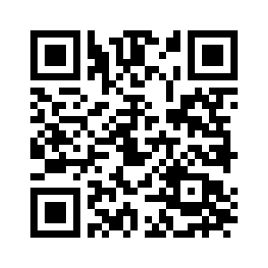
Watch and discover
https://www.youtube.com/watch?v=JSV4VZ8gdUQ

