Slide 1
T12 H2 Writing Main Body Paragraphs

Slide 2
Main body paragraphs
In the last cycle we studied essay planning and structure for EAP writing.
What do you remember:
What should you include in a main body paragraph?
How could it be organised?

Slide 3
Building body paragraphs
It’s important to be:
Clear about what your paragraphs will be about
What points you will make
How you will develop those points.
Now, let’s look at this process in action.

Slide 4
Task: Present an argument in favour of or against the following opinion: Studying at university is a great opportunity for all, and is even more beneficial if the university attended is in a foreign country. Please use relevant facts, ideas and examples. You may use the topic ideas below to support your argument if you choose. Topic ideas: Personal development Professional opportunities Costs Cultural issues You should write at least 300 words.

Slide 5
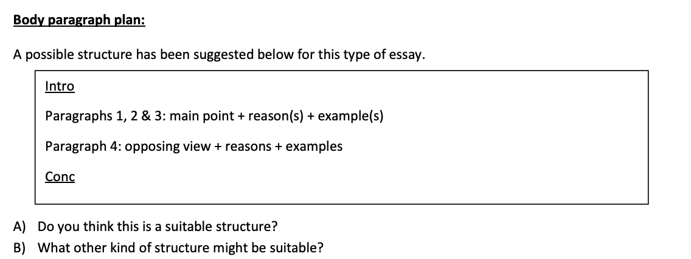
Plan

Slide 6
Sample Introduction
Now, read the introduction below. Can you identify:
What is the writer’s opinion?
How have they made the introduction specific to the task?
Introduction
It is widely believed that holding a university degree has various benefits, and it is argued by some that holding an international degree is even more beneficial. Reasons include the fact that it gives access to better jobs, attain high salaries, develop their skills, and for some, to learn a foreign language. This essay will argue in favour of studying abroad.

Slide 7
Sample body paragraph
Identify:
Main point
Reason
Example
Another benefit in holding an international degree is that most foreign universities have placement programmes or on-hand courses. These experiences in a workplace environment gives students the skills they require when tackling harder obstacles in their jobs. Therefore, this leads to a stronger CV and the likelihood of being hired by well-known companies. Generally, it could be argued that companies and businesses prefer candidates who already have experience in foreign countries.

Slide 8
Sample body paragraph
Identify:
Main point
Reason
Example
Another benefit in holding an international degree is that most foreign universities have placement programmes or on-hand courses. These experiences in a workplace environment gives students the skills they require when tackling harder obstacles in their jobs. Therefore, this leads to a stronger CV and the likelihood of being hired by well-known companies. Generally, it could be argued that companies and businesses prefer candidates who already have experience in foreign countries.

Slide 9
Body Paragraph Planning
Now, add your ideas to the table below:
Main point | Reason | Example
Placement programme opportunities | Stronger CV and preference from well-known companies | Skills development in preparation for the workplace
2)
3)
4)
Compare with your partner or group.

Slide 10
Plan Review: Discussion of different viewpoints
Now, let’s think about discussing different viewpoints.
Remember, you must discuss different viewpoints (the other opinions)
to get a score over 60.

Slide 11
Plan Review: Discussion of different viewpoints
Identify below:
Opposing view
Reasons
Refutation
Language used to introduce contrast
Conversely, some may believe that studying in a foreign country is not an option as they might face multiple obstructions such as language barriers, unable to integrate, cultural shock, and homesickness. However, statistics and surveys have proven that students do generally integrate with foreign students as well as adapt to that country’s culture and traditions. One may face cultural shock as well as homesickness but in general students adjust after a short period of time and embrace the experience.

Slide 12
Plan Review: Discussion of different viewpoints
Identify below:
Opposing view
Reasons
Refutation
Language used to introduce contrast
Summary of paragraph/topic sentence
Conversely, some may believe that studying in a foreign country is not an option as they might face multiple obstructions such as language barriers, unable to integrate, cultural shock, and homesickness. However, statistics and surveys have proven that students do generally integrate with foreign students as well as adapt to that country’s culture and traditions. One may face cultural shock as well as homesickness but in general students adjust after a short period of time and embrace the experience.

Slide 13
Plan Review: Discussion of different viewpoints
Now, complete the table below with your ideas:
Opposing View | Reason | Refutation
Compare with your partner or group.

Slide 14


Slide 15
