Slide 1
Where do you stand? Science & Technology

Slide 2
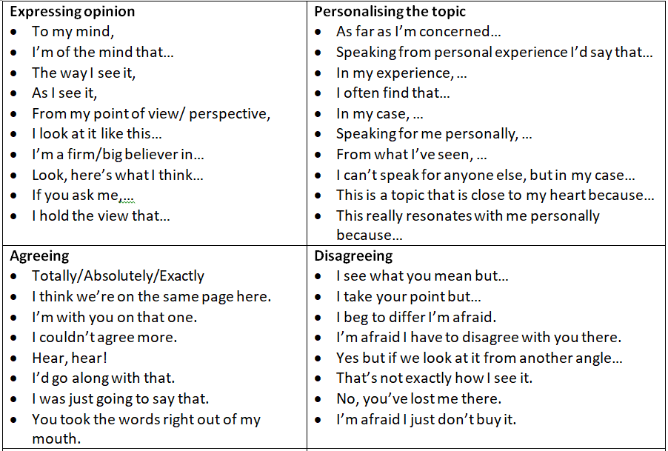
Artificial intelligence is a threat to humankind.

Slide 3
We should try to bring extinct animals back to life.

Slide 4
Humans will colonise Mars this century.

Slide 5
Cosmetic surgery should be banned except for cases of accidental disfigurement.

Slide 6
Aging can be slowed down or even reversed.

Slide 7
Children should take classes on nutrition at school.

Slide 8
Unhealthy foods and drinks should be banned.

Slide 9
Intelligence comes from your genes not your upbringing.

Slide 10
People who will live forever have already been born.

Slide 11
Artificial intelligence is just the next stage of evolution.

Slide 12
Genetically modified foods are the only way to feed the growing population.

Slide 13
Nuclear weapons have made the world a safer place.

Slide 14
Most jobs will eventually be done by robots or computers.

Slide 15
Space exploration is a waste of money.

