Slide 1

EAP Writing Revision
Resit: Monday 9th August

Slide 2
Important Reminder
Your EAP writing exam must be all your own words
All essays will be uploaded to Turnitin to check for plagiarism
You must not memorise full sentences to use in the exam

Slide 3
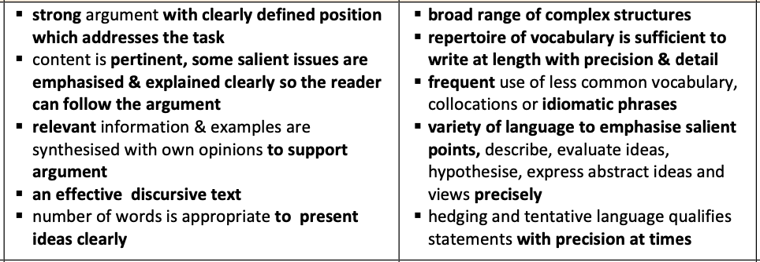
Task Achievement and language Range (70)

Slide 4
Task Achievement: to achieve 70+
Your view needs to be clearly stated in your introduction (use a clear thesis statement)

Slide 5
Task Achievement: to achieve 70+
Your view needs to be clearly stated in your introduction (use a clear thesis statement)
You need to discuss both sides of the view in your essay

Slide 6
Task Achievement: to achieve 65+
Your view needs to be clearly stated in your introduction (use a clear thesis statement)
You need to discuss both sides of the view in your essay
First - read the essay question carefully and identify the key words. Example question:
Technology is making us lazy. We should stop using computers, gadgets and apps to do so many things for us, and try to be more physically and mentally active.

Slide 7
Task Achievement: to achieve 65+
Your view needs to be clearly stated in your introduction (use a clear thesis statement)
You need to discuss both sides of the view in your essay
First - read the essay question carefully and identify the key words. Example question:
Technology is making us lazy. We should stop using computers, gadgets and apps to do so many things for us, and try to be more physically and mentally active.

Slide 8
Brainstorm ideas
Lazy - can do everything from home, working, shopping etc
Negatives
Less active - play online games instead of exercise
Technology
More convenient - creates more time to do other things
Positives
Better connected to friends and family

Slide 9
Technology is making us lazy. We should stop using computers, gadgets and apps to do so many things for us, and try to be more physically and mentally active.
The development of technology has been growing rapidly and it has become an important part of people’s daily lives. People can access to it through electronic devices like computers and phones every day, bringing them convenience. On the other hand, it may lead to the problem of being physically and mentally inactive. This essay will argue that technology does not make us lose the spirit in doing sports and we should not stop using the electronic devices that help us accomplish things.
Are both sides discussed? What is the student’s opinion?
Example Introduction

Slide 10
Technology is making us lazy. We should stop using computers, gadgets and apps to do so many things for us, and try to be more physically and mentally active.
The development of technology has been growing rapidly and it has become an important part of people’s daily lives. People can access to it through electronic devices like computers and phones every day, bringing them convenience. On the other hand, it may lead to the problem of being physically and mentally inactive. This essay will argue that technology does not make us lose the spirit in doing sports and we should not stop using the electronic devices that help us accomplish things.
Are both sides discussed? What is the student’s opinion?
Example Introduction

Slide 11
Technology is making us lazy. We should stop using computers, gadgets and apps to do so many things for us, and try to be more physically and mentally active.
What does the first sentence do? How has the student linked their ideas?
The development of technology has been growing rapidly and it has become an important part of people’s daily lives. People can access to it through electronic devices like computers and phones every day, bringing them convenience. On the other hand, it may lead to the problem of being physically and mentally inactive. This essay will argue that technology does not make us lose the spirit in doing sports and we should not stop using the electronic devices that help us accomplish things.
Example Introduction

Slide 12
Technology is making us lazy. We should stop using computers, gadgets and apps to do so many things for us, and try to be more physically and mentally active.
The development of technology has been growing rapidly and it has become an important part of people’s daily lives.
Example Introduction
What does the first sentence do?
Introduces the topic. One sentence is enough.

Slide 13
Technology is making us lazy. We should stop using computers, gadgets and apps to do so many things for us, and try to be more physically and mentally active.
The development of technology has been growing rapidly and it has become an important part of people’s daily lives. People can access to it through electronic devices like computers and phones every day, bringing them convenience. On the other hand, it may lead to the problem of being physically and mentally inactive. This essay will argue that technology does not make us lose the spirit in doing sports and we should not stop using the electronic devices that help us accomplish things.
How has the student linked their ideas?
Example Introduction

Slide 14
Task Achievement: to achieve 65+
Your view needs to be clearly stated in your introduction (use a clear thesis statement)
You need to discuss both sides of the view in your essay
Your main body paragraphs should expand on and support your thesis statement

Slide 15
Task Achievement: to achieve 65+
Your view needs to be clearly stated in your introduction (use a clear thesis statement)
You need to discuss both sides of the view in your essay
Your main body paragraphs should expand on and support your thesis statement
You should try to divide the number of words equally between each main body paragraph (not one very long and one very short)

Slide 16
Task Achievement: to achieve 65+
Your view needs to be clearly stated in your introduction (use a clear thesis statement)
You need to discuss both sides of the view in your essay
Your main body paragraphs should expand on and support your thesis statement
You should try to divide the number of words equally between each main body paragraph (not one very long and one very short)
Your points should all be relevant to the question

Slide 17
Analysis of sample essay
Example Introduction
The development of technology has been growing rapidly and it has become an important part of people’s daily lives. People can access to it through electronic devices like computers and phones every day, bringing them convenience. On the other hand, it may lead to the problem of being physically and mentally inactive. This essay will argue that technology does not make us lose the spirit in doing sports and we should not stop using the electronic devices that help us accomplish things.
How many main body paragraphs will this student include?
What will be the topic of each paragraph?
What will they include in their conclusion?

Slide 18
Analysis of sample essay
Read the sample essay and check your answers
How many main body paragraphs does this student include?
What is the topic of each paragraph?
What do they include in their conclusion?

Slide 19
Language Range to achieve 70+
You should use a broad range of different grammatical structures

Slide 20
Language Range to achieve 70+
You should use a broad range of different grammatical structures
You should use a broad range of vocabulary and collocations

Slide 21
Language Range to achieve 70+
You should use a broad range of different grammatical structures
You should use a broad range of vocabulary and collocations
You should use hedging language (can, may, seems to, might..) to qualify your statements

Slide 22
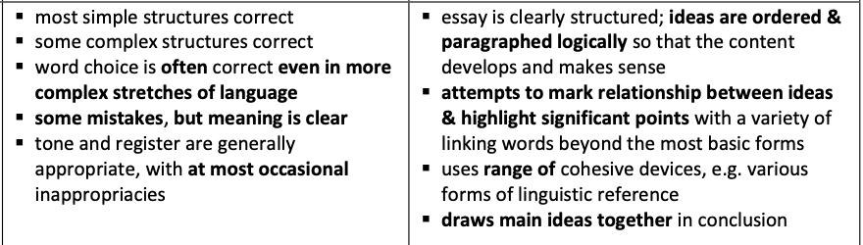
Language Accuracy, Cohesion and Coherence

Slide 23
Sample Essay: Language Analysis
Highlight the
Cohesive devices
Hedging (cautious language)
Collocations and topic-specific vocabulary

Slide 24
Cohesive devices
However, the newly developed applications and devices encourage people to be more active in their lives. Some innovative apps have the function of reminders, sending the users notifications to remind them to go out to the gym. Also, some gadgets are designed as watches so people can wear them to count the number of steps they took throughout the day. This encourages people to reach their targets and goals every day in order to stay healthy. In addition, the variety of information they are able to access to can stimulate their eagerness in finding out more about that specific topic and allow them to think about it independently. Since there is a broad scope of topics, some of the tourist spots or attractive sceneries may provide ideas for friends and families to hangout during the weekends, persuading people to leave their homes and go out to see the world.

Slide 25
Hedging
Some may say that technology is increasing the amount of lazy people in the society. People tend to stay at home all the time to watch movies from the internet or order takeaway through a click. They can even shop online using the app. There is also a possibility that the frequency of going out to socialise with others will decrease because they can just facetime call or text each other. Potentially, technology may lead to they may also stop using their brains to think and search everything online instead. This could impact in people’s physical and mental health like obesity for not doing sports and isolation for not socialising face-to-face.

Slide 26
Collocations and topic-specific vocabulary
However, the newly developed applications and devices encourage people to be more active in their lives. Some innovative apps have the function of reminders, sending the users notifications to remind them to go out to the gym. Also, some gadgets are designed as watches so people can wear them to count the number of steps they took throughout the day. This encourages people to reach their targets and goals every day in order to stay healthy. In addition, the variety of information they are able to access to can stimulate their eagerness in finding out more about that specific topic and allow them to think about it independently. Since there is a broad scope of topics, some of the tourist spots or attractive sceneries may provide ideas for friends and families to hangout during the weekends, persuading people to leave their homes and go out to see the world.

Slide 27
Conclusion
In conclusion, although technology may increase people’s tendency to stay at home, it brings efficiency and free time to people’s daily lives as well as encouraging people to do sports, hangout with friends and think critically. Therefore, there is no need to stop using technology because it helps people to do many things, including being active in both our bodies and our minds.

Slide 28
Conclusion
Cohesive devices, summary of both sides, restatement of thesis
In conclusion, although technology may increase people’s tendency to stay at home, it brings efficiency and free time to people’s daily lives as well as encouraging people to do sports, hangout with friends and think critically. Therefore, there is no need to stop using technology because it helps people to do many things, including being active in both our bodies and our minds.

Slide 29
Extra Practice: Worksheet 2

Slide 30
Useful Resources
https://www.eapfoundation.com/writing/skills/
(Particularly for hedging and cohesion)
https://academic-englishuk.com/
(particularly for structure, what to include in each section of your essay, paragraphing)
https://www.flo-joe.co.uk/cae/students/wordbank/
Build your word power, short daily exercises

Slide 31
Reflection
What have you learned from today’s session that will help you improve your writing?
Menti.com 5605 7003

Slide 32
Important Reminder
Your EAP writing exam must be all your own words
All essays will be uploaded to Turnitin to check for plagiarism
You must not memorise full sentences to use in the exam

