Slide 1
T12 H4 Writing Conclusions
EAP111 Writing Prep 2

Slide 2
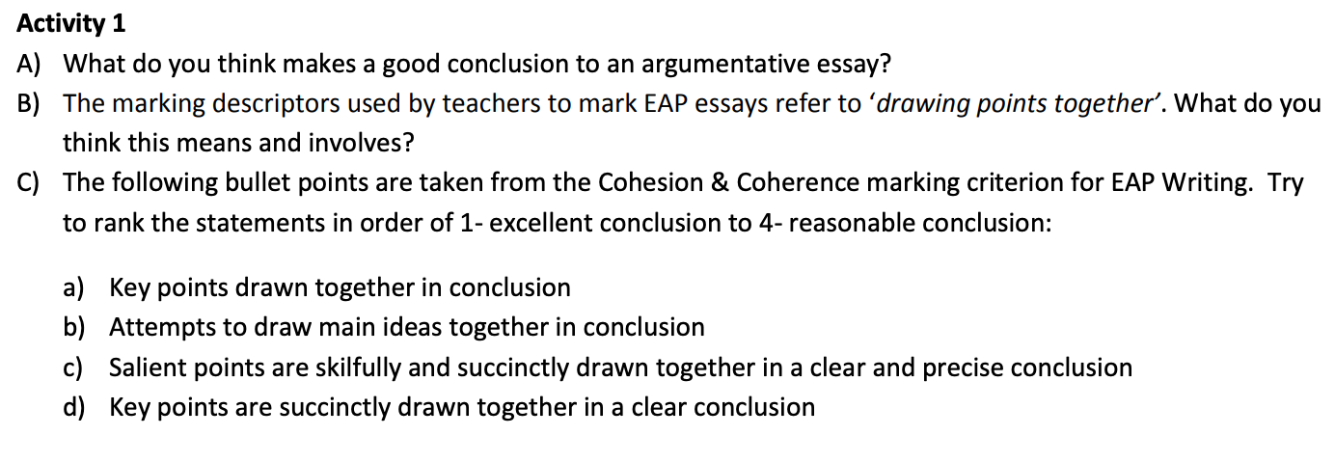
Discussion

Slide 3
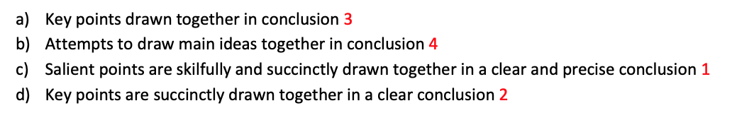

Slide 4
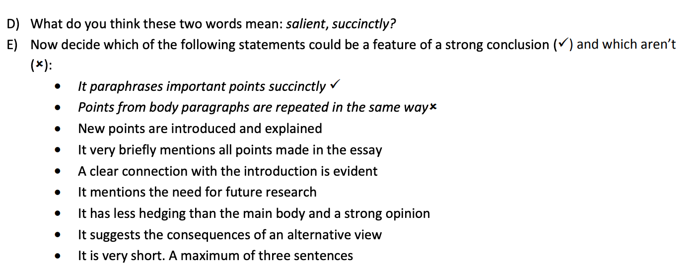

Slide 5
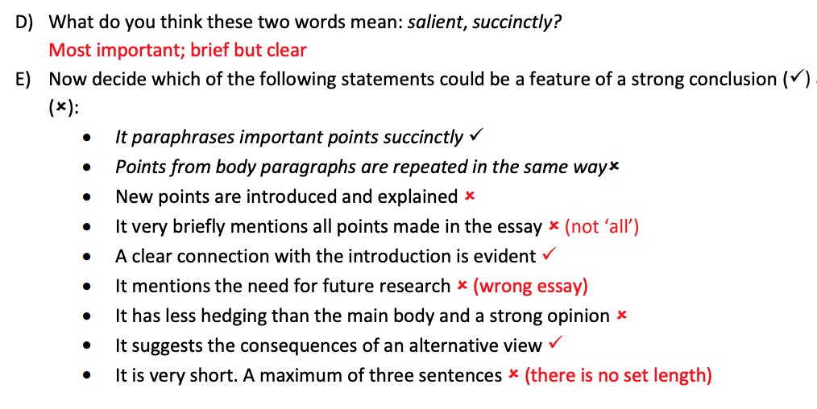
Answers

Slide 6
Sample conclusion
Read the conclusion below.
Does it:
Paraphrase important points succinctly?
Used hedging language?
Suggested the consequences of an alternative view?
How could you improve this conclusion? Share your ideas with the class.
To summarize, it can be said that studying abroad and holding an international degree has more benefits than studying in one’s home country. While there may be drawbacks when studying in an unknown country, the benefits outweigh the disadvantages.

Slide 7
Sample conclusion
Read the conclusion below.
Does it:
Paraphrase important points succinctly? – yes to some extent
Used hedging language?
Suggested the consequences of an alternative view? – This sentence touches
On the opposing view but does not explain the consequences.
To summarize, based on the reasons provided, it could be said that studying abroad and holding an international degree has more benefits than studying in one’s home country. While there may be drawbacks when studying in an unknown country, the benefits outweigh the disadvantages.

Slide 8
Write your conclusion
Now go back to the first essay plan from last lesson.
Make some notes and write a suitable conclusion.
Share your conclusion on the nearpod for feedback.

Slide 9
Homework: Submit the essay
Please submit your essay on the VLE link as instructed by your tutor.

