Slide 1
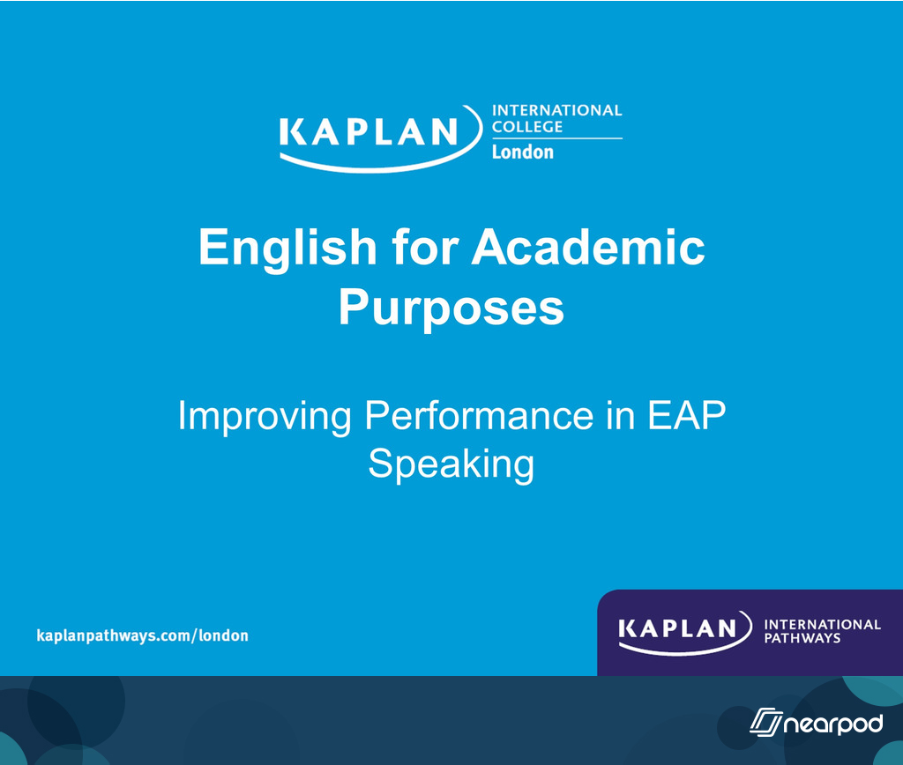

Slide 2
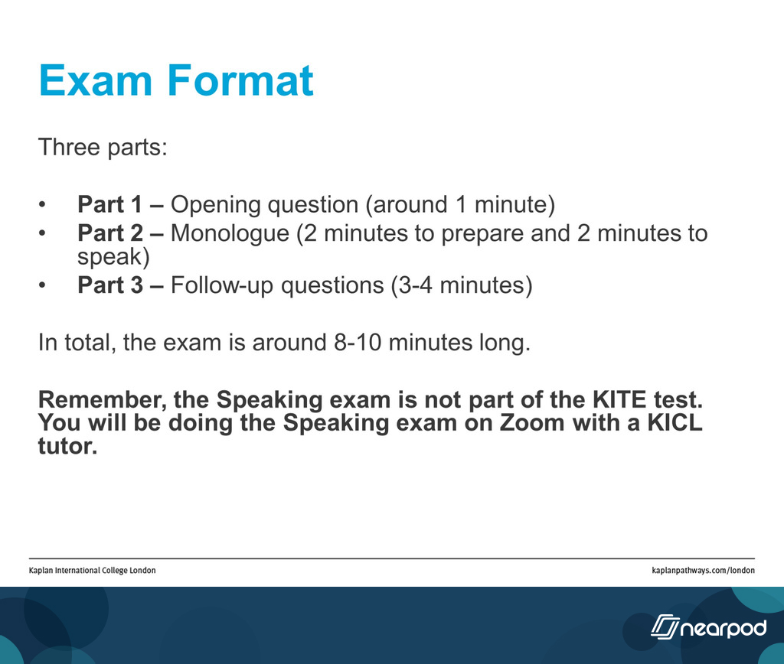

Slide 3
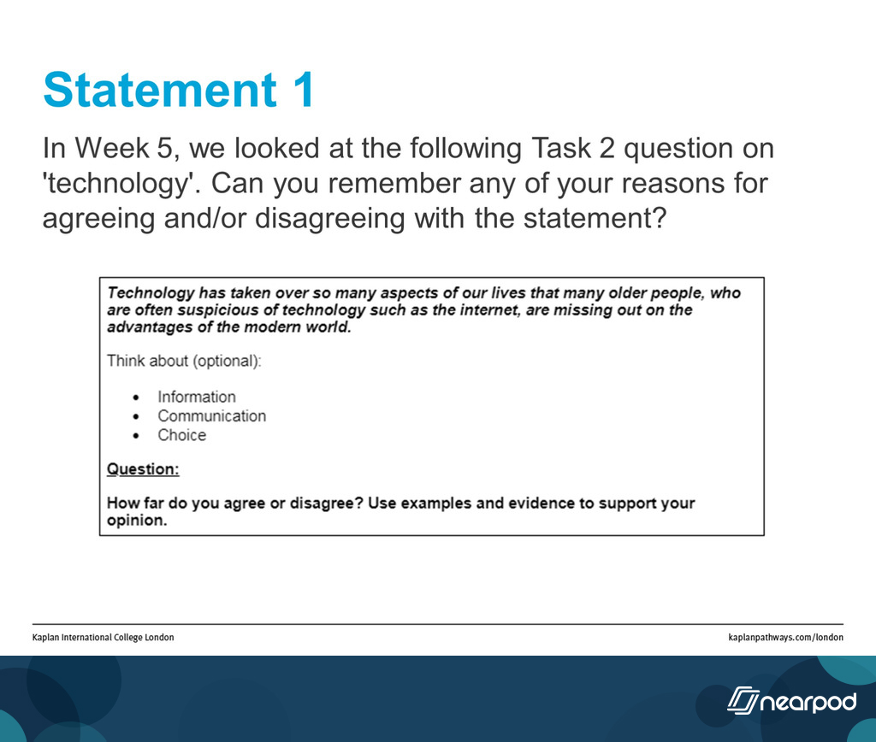

Slide 4
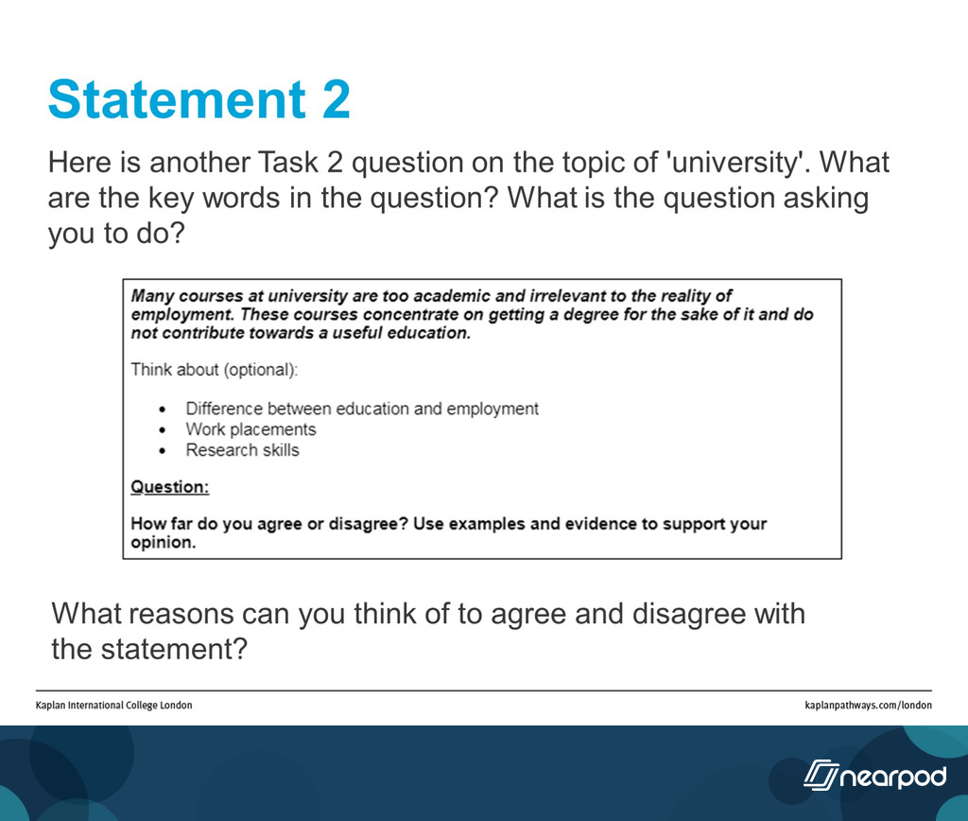

Slide 5
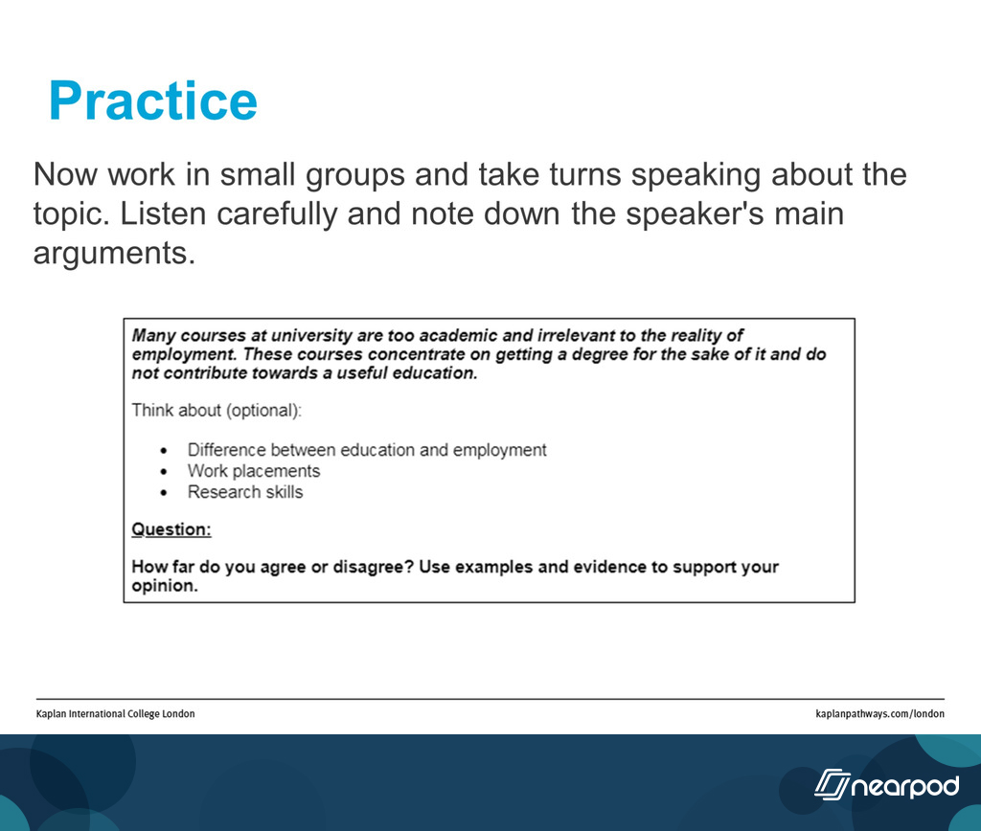

Slide 6
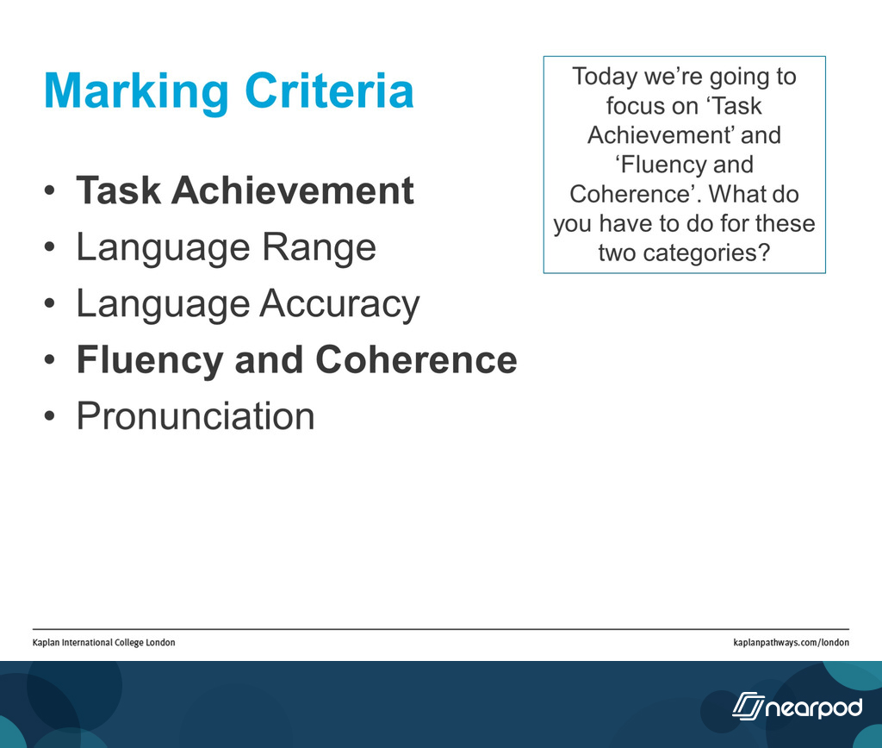

Slide 7
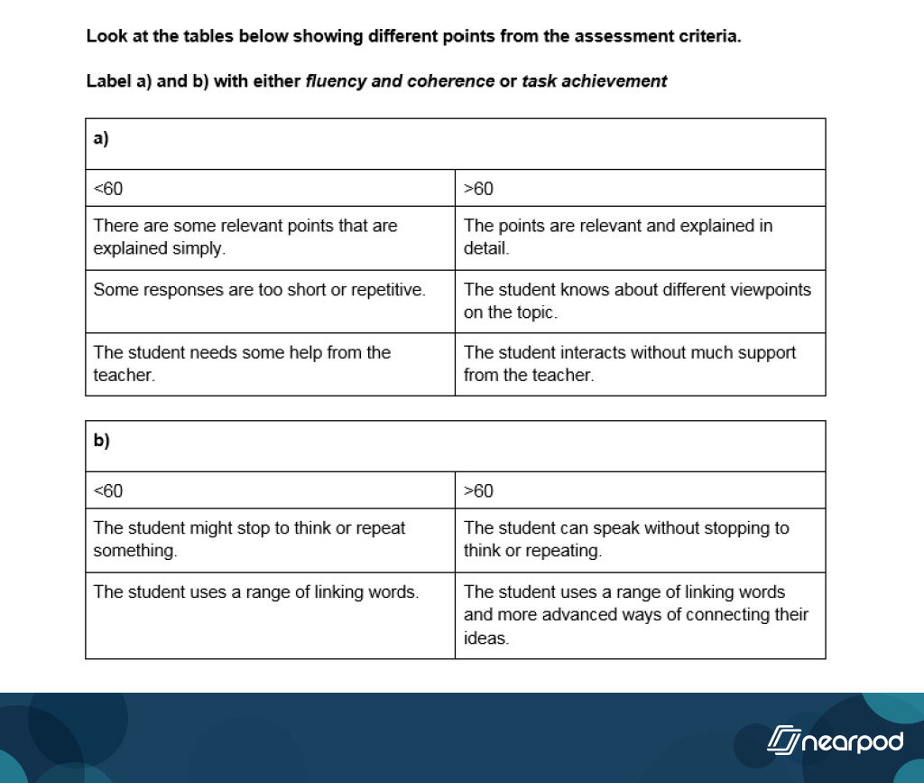

Slide 8

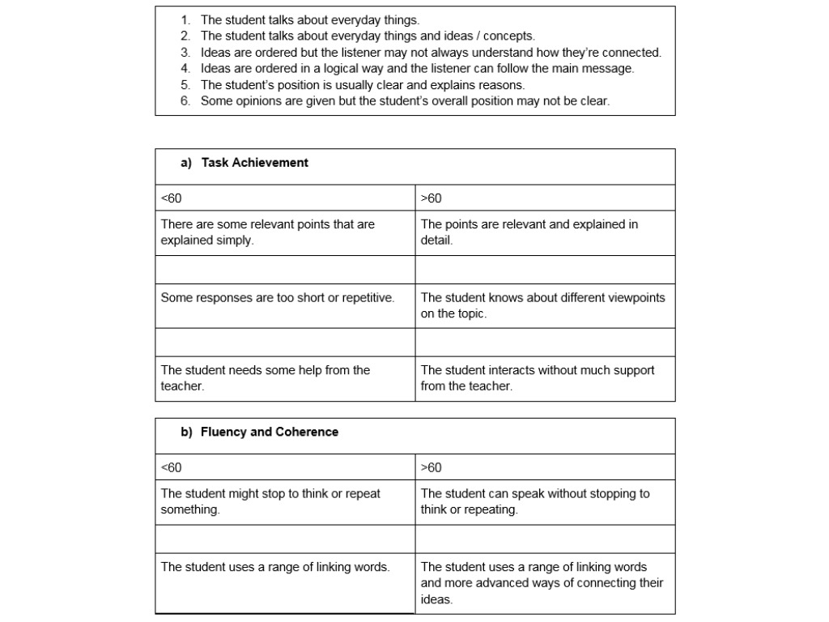
Activity 3: Look at the missing statements below. Work with your partner and decide where they should go in the table.
Task Achievement or Fluency and Coherence?
<60 or >60?

Slide 9
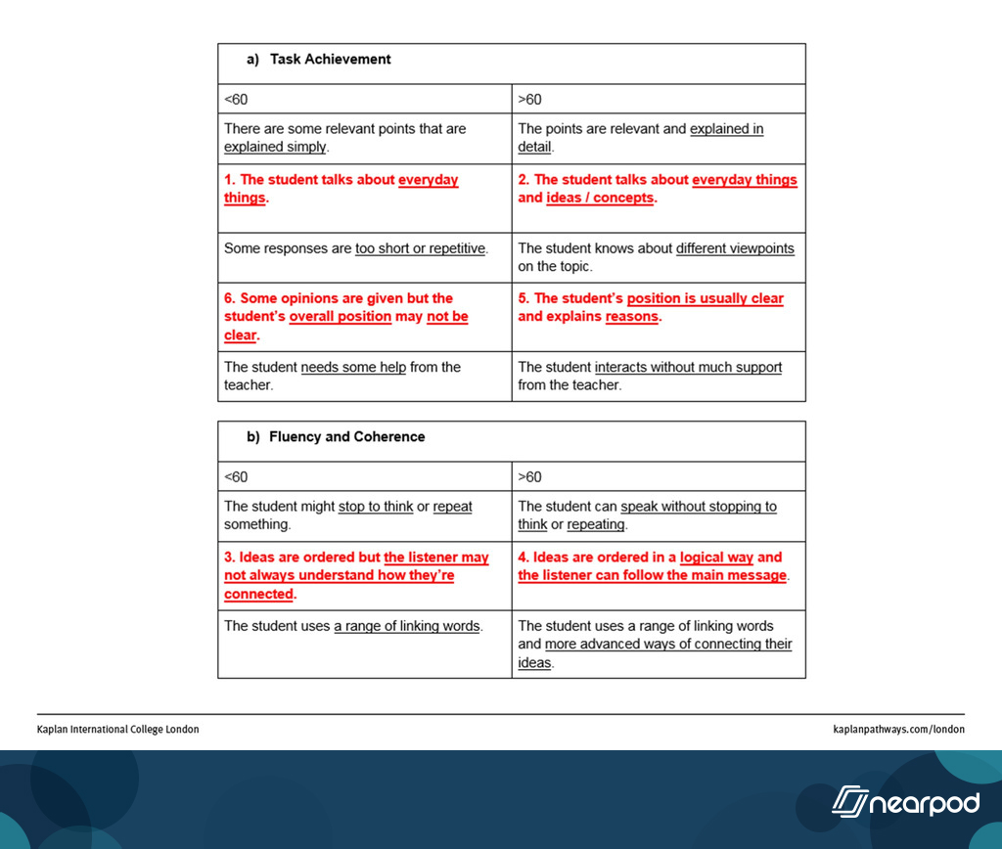

Slide 10

“[University education] doesn't prepare you fully for employment, doing projects like work placement will be useful cos then would be a year of experience that you can have that's gonna be, there's going to be just like .. what the real life job is. So, I think that when universities provide this kind of preparation, this work placements, they are not only preparing you academically, but also preparing you .. erm .. for your employment”
The idea is explained in detail and is from a >60 exam.
The idea is explained simply and is from a <60 exam.

Slide 11
“some old people maybe in the past time, they cannot to know, know the the news [technology], maybe it can let them erm .. miss some”
The idea is explained in detail and is from a >60 exam.
The idea is explained very simply and is from a <60 exam.

Slide 12
“so people can more to ... er ... more to ... face ... how to how more to use .. more to use the this [technology] but for the”
The student can speak without repeating or hesitating too much. This is from >60 exam.
The student might stop to think or repeat something. This is from a <60 exam.

Slide 13
“[University education] doesn't prepare you fully for employment, doing projects like work placement will be useful cos then would be a year of experience that you can have that's gonna be, there's going to be just like .. what the real life job is. So, I think that when universities provide this kind of preparation, this work placements, they are not only preparing you academically, but also preparing you .. erm .. for your employment”
The student uses a range of linking words and more advanced ways of connecting their ideas. This is from a >60 exam.
The student uses a range of linking words. This is from a <60 exam.

Slide 14
“cos when you're in university you're studying for your own exams but, when you're working you're doing it for probably a whole group of people so it's not only about you but it's like [?] team work as well.”
The student talks about concrete topics (everyday things) and abstract topics (ideas / concepts). This is from a >60 exam.
The student talks about concrete topics (everyday things). This is from a <60 exam.

Slide 15
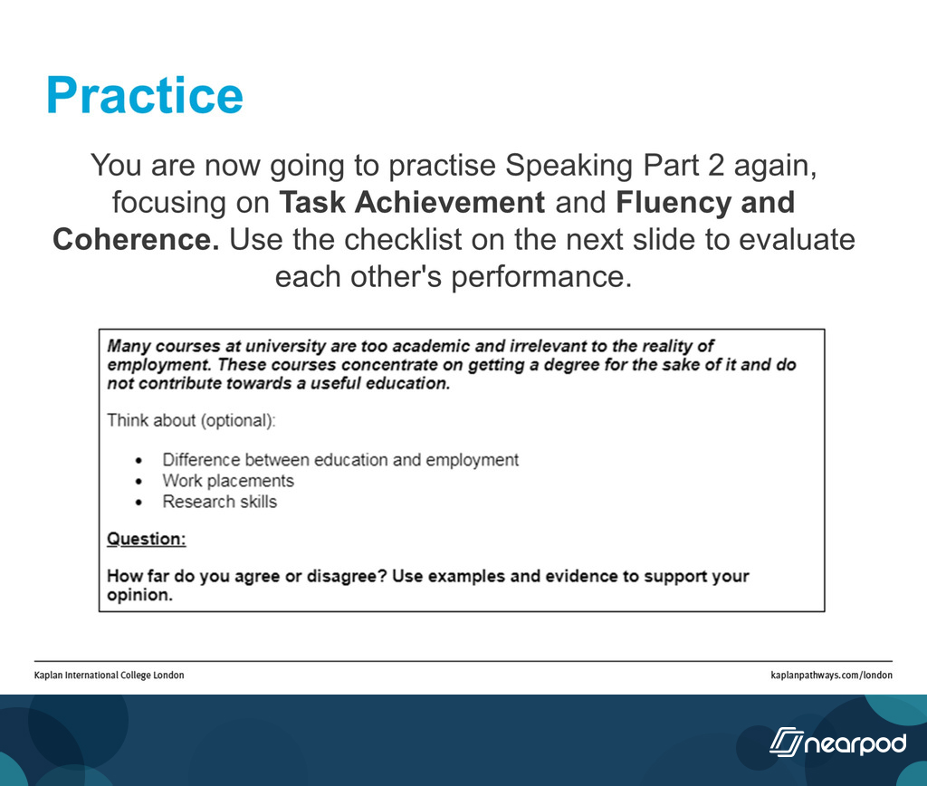

Slide 16
