Slide 1
KICL 111 / FC300 / PM600
Hedging Language

Slide 2
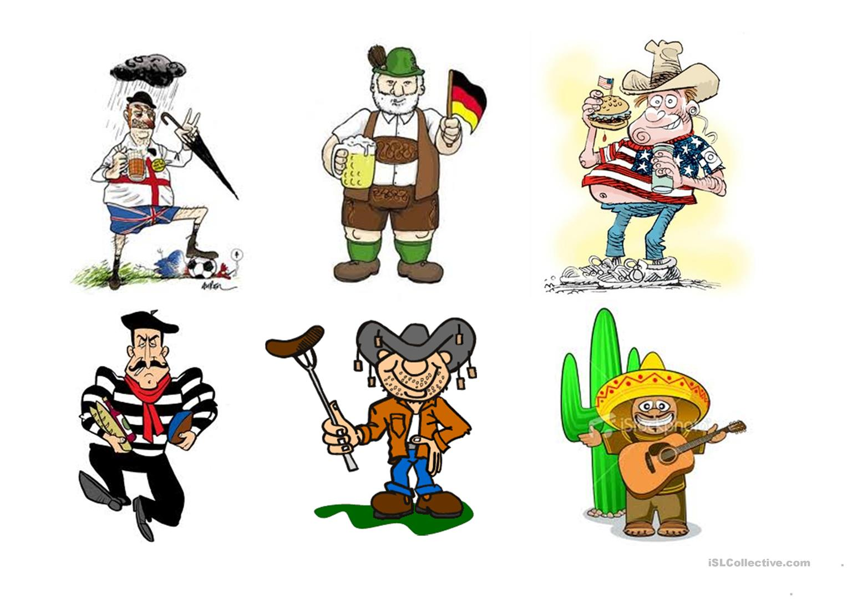
Nationalities
Where do these people come from?

Slide 3
Nationalities
Do all the people from these countries dress/look like this?
Do any of the people from these countries ever dress/look like this?

Slide 4
Nationalities
So, these are _ _ _ _ _ _ _ _ _ _ _.

Slide 5
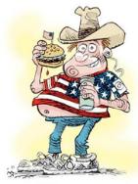
Nationalities
These are stereotypes and they can lead to us making statements like this:
“Americans are fat and love hamburgers.”

Slide 6
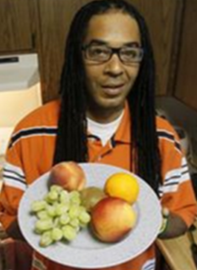
Stereotypes & Over-generalisations
Stereotypes can be seen as a form of over-generalisation, i.e. something that there may be some truth to but which isn’t 100% true 100% of the time.
“Some Americans are fat and love hamburgers, but some are slim vegetarians.”
vs

Slide 7
Hedging Language
In academic writing, we try to avoid over-generalisation by using cautious or tentative language. This is known as ‘hedging’. Look at these two sentences:
Americans are fat and love hamburgers.
Newspaper reports indicate that many Americans tend to be overweight and hamburgers are often very popular.
What’s the difference between the two sentences?
vs

Slide 8
Hedging Language
Americans are fat and love hamburgers.
Newspaper reports indicate that many Americans tend to be overweight and hamburgers are often very popular.
The first sentence indicates a statement of fact, but it is incorrect and can be very easily disproven.
The second sentence, on the other hand, is more tentative. It acknowledges that more research may be needed to prove it is fact.
vs

Slide 9
Hedging Language
Hedging language helps to make statements as accurate and fair as possible.
There is a wide range of hedging words and phrases and it is important to choose one that reflects the strength of the supporting evidence.
For example: “Newspaper reports indicate that many / some / several / very few Americans…”
vs

Slide 10
Hedging Language
Can you find the examples of hedging language below?
Newspaper reports indicate that many Americans tend to be overweight and hamburgers are often very popular.
There is a strong possibility that learning a foreign language will improve a person’s job prospects.
It is commonly believed that modern technology is making us lazy.
Students who get a good IELTS score will possibly do better at university than those who do not.
Watching films with the subtitles on may help to improve students’ English.
It is possible that many companies will not survive the recession.

Slide 11
Hedging Language
Can you find the examples of hedging language below?
Newspaper reports indicate that many Americans tend to be overweight and hamburgers are often very popular.
There is a strong possibility that learning a foreign language will improve a person’s job prospects.
It is commonly believed that modern technology is making us lazy.
Students who get a good IELTS score will possibly do better at university than those who do not.
Watching films with the subtitles on may help to improve your English.
It is possible that many companies will not survive the recession.

Slide 12
Can you think of any more words/phrases to add to the table?
Effect | Language | Example
Saying things are more or less certain or probable | Modal verbs | May
 | Adverb | This will possibly…
 | Noun | There is a possibility…
 | Verb | This indicates that…
 | Adjective | It is possible that…
Saying things are more or less certain or probable | Frequency adverb | Often
 | Quantifier | Many
Distancing | Verb | It is (commonly) believed that…

Slide 13
Effect | Language | Example
Saying things are more or less certain or probable | Modal verbs | May, might, can, could
 | Adverb | Possibly, certainly, probably, perhaps
 | Noun | There is a possibility… There is a probability… There is a chance…
 | Verb | This shows/indicates that… It appears/seems that… This suggests that… It tends to…(+ inf.)
 | Adjective | It is possible / certain / probable / possible / likely / unlikely that…
Saying things are more or less certain or probable | Frequency adverb | Always / usually / often / sometimes / rarely / never
 | Quantifier | All / most / many / some / several /certain / a few
Distancing | Verbs | It is (commonly) believed / claimed / thought / argued that…

Slide 14
Hedging Language
Complete the sentences with an appropriate word/phrase.
The popularity of Facebook ………………… to be decreasing.
Watching television ………………… be bad for you.
It is ………………… that sea levels are going to rise.
There is a ………………… that poor performance in exams is due to undiagnosed learning difficulties.
It is ………………… that life today is better than it used to be.
Testing ………………… puts unnecessary pressure on students.
………………… students are lazy.
Governments ………………… protect their people.

Slide 15
Hedging Language
Suggested answers:
The popularity of Facebook appears to be decreasing.
Watching television may be bad for you.
It is highly likely that sea levels are going to rise.
There is a possibility that poor performance in exams is due to undiagnosed learning difficulties.
It is commonly believed that life today is better than it used to be.
Testing perhaps puts unnecessary pressure on students.
Some students are lazy.
Governments usually protect their people.

Slide 16
Hedging Language
Use hedging language to soften these claims.
Obtaining a divorce is too easy, so people do not think before they get married.
Smoking causes cancer.
Money is the most important thing in life.
Everyone uses the Internet.
Climate change is caused by human activities.
Playing violent video games makes children aggressive.
The public trust news reports.
Digital technology will change the way people work.

