Slide 1
Digital Pathways
Life and Career Skills
Problem Solving

Slide 2
Learning Objectives
By the end of this lesson, you will be able to:
List at least four problems that can occur in a workplace
Explain how Ishikawa’s Fish Bone diagram can be used to solve work related problems
Produce a Fish Bone diagram for a company
Make suggestions to resolve the problems that the company are experiencing to improve the efficiency of the business

Slide 3
Introduction
There are many different problems that can affect the performance of a company
Some problems are simple and can be resolved quickly but other problems may be more complex
Solving problems involves time, energy, thinking and sometimes money
Choosing the correct solution is a key part of the problem -solving process
Ishikawa’s Fish Bone Diagram is a useful tool for identifying the root cause of a problem
Identifying the root cause of a problem and taking action will help a company to resume its business activities

Slide 4
Simple versus complex problems
Simple
Every day operational issues that can be quickly resolved. For example, an employee may be off work for a day or two because they are sick
Complex
Complex problems have wider -reaching implications for the company, its employees and sometimes customers

Slide 5

Student Activity
Make a list of at least four types of complex problems that you think could affect the performance of a company.
Post your ideas on this Padlet: (Teacher to insert link)
Notes:
Individual teachers to create a Padlet and insert the link on this slide

Slide 6

Group discussion
How do you think the problems you have listed could affect:
Employees
The customers of a company
The company
Type your answers into the chat box

Slide 7
Fishbone or Cause and Effect Diagram
Developed by Professor Kaoru Ishikawa in Tokyo University
Fishbone diagrams graphically illustrate the relationship between a problem and the possible root causes of the problem
It is often referred to a Fishbone diagram because of the way it looks
Fishbone diagrams enables team member to work collaboratively to analyse the problems and make decisions to resolve the problem

Slide 8
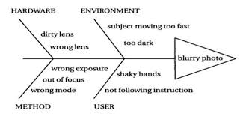
The scales of the “fish” represent the possible root causes of the problem
The problem
Figure 1- Using a Fishbone Diagram to solve photography problems
Michigan State University (2016)

Slide 9
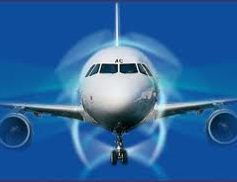
Group activity
Read the case study “JD Airlines” and produce a Fishbone Diagram to identify some of the root causes that are affecting efficiencies in the baggage handling department. Make some recommendations about the action that the company could take to improve the performance of this department.
You can produce your Fishbone Diagram and your recommendations using a word document or you can use the worksheet.
Be prepared to share your answers with the rest of the class.

Slide 10
Exit Ticket
List three complex problems that could occur in a company
Describe how work- related problems could affect a company
Assess the usefulness of a Fishbone diagram for solving problems
Exit Ticket

Slide 11
Images used in this presentation
Problems- https://thirdspacelearning.com/
Discussion-Tips for TEFL discussion classes (global-english.com)

