Slide 1
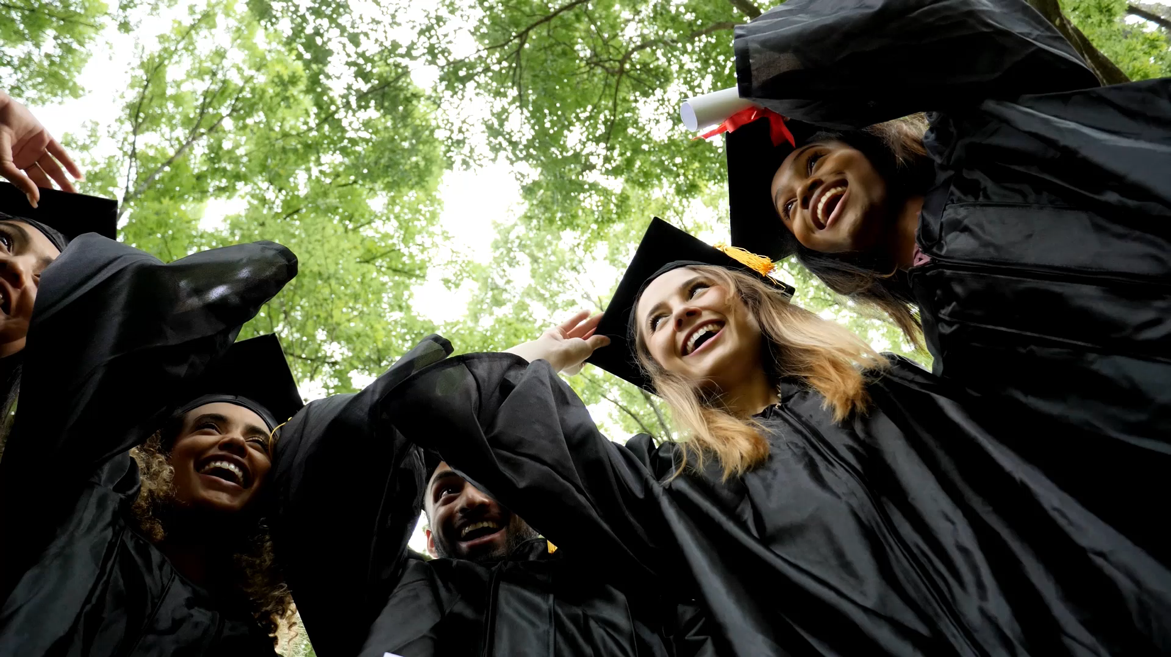
My University City
A Research Activity

Slide 2
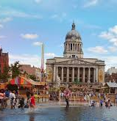
Research, make and upload/present a 3 minute presentation on your future university city.
Focus on the non-academic aspects of living there.
What is the city like? Is it a big place? Is the university a big part of the city? Is it a very cosmopolitan place? Are there lots of international students?
What is the social life like? Does it have a big sports team? Does it have a lot of music venues? Are there markets or lots of food places?
What is the University like? What is it famous for? Which campus will you be on? What societies does it have? Which ones will you join?
What are you looking forward to seeing or doing when you get there? Are there any landmarks? Is there a famous local food? Is there a specific place that you want to visit?
Experiment with screen recording and visuals, make the presentation visually interesting, focus on a couple of different aspects of the city.

Slide 3
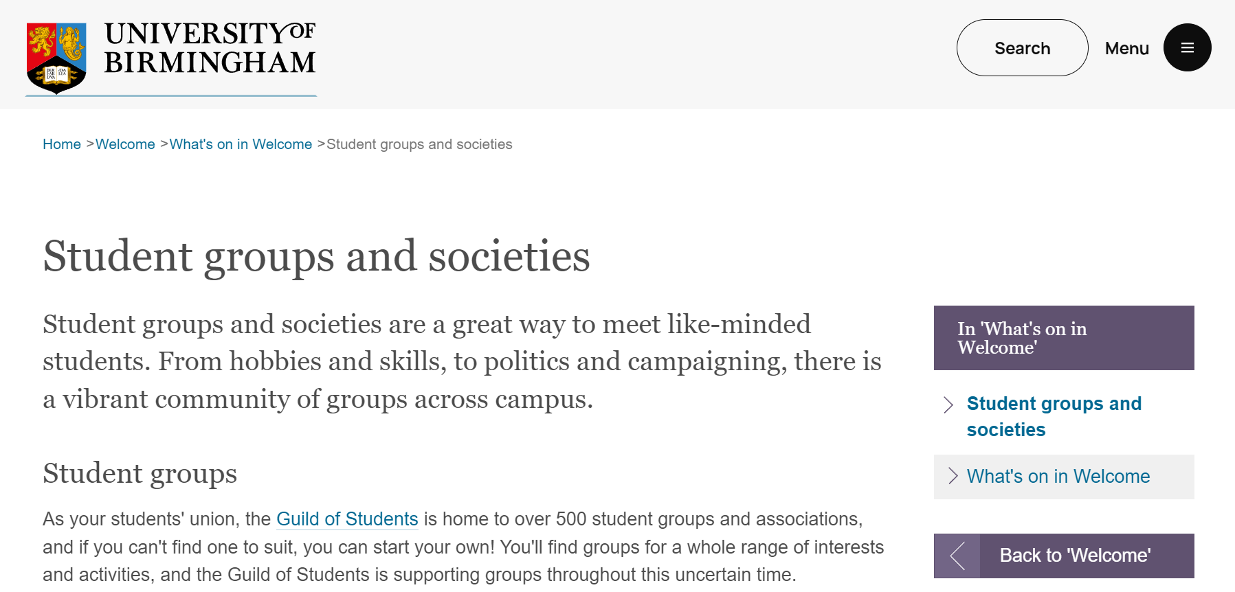
Look for the social groups and Societies at your University
Search for your university name + “Groups and Societies”
What are you interested in?
What would you like to try?
University social groups are a great way to meet people who aren’t from your course, and make sure you don’t just stay within your “comfort zone”.
Groups can be related to sports, films, culture, languages, politics, etc, etc

Slide 4
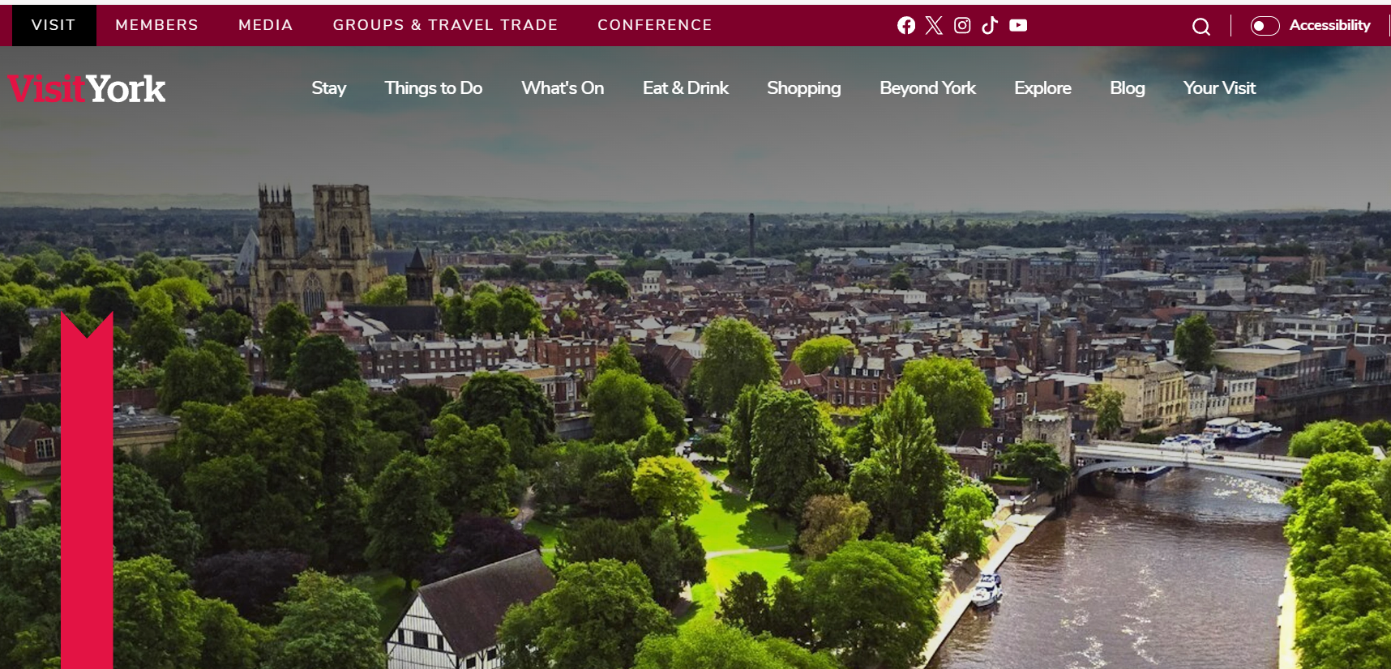
Check out the tourist websites for your city. What do they recommend?
What will you go and see while you are there?

Slide 5

You can work on this individually or as a pair (no big groups please)
Time the presentation to three minutes
Record the presentation on PowerPoint, or use an alternative platform such as Prezi
Upload the presentation (your tutor will tell you where)
We will watch the presentations later this week
We will award a PM600 Oscar to the winner

