Slide 1
PM600
Research Project
The Research Proposal

Slide 2
What is a research proposal?
The University of Birmingham offers this helpful definition:
http://www.birmingham.ac.uk/schools/law/courses/research/research-proposal.aspx
A research proposal is a concise and coherent summary of your proposed research. It sets out the central issues or questions that you intend to address.
It outlines the general area of study within which your research falls, referring to the current state of knowledge and any recent debates on the topic. It also demonstrates the originality of your proposed research.

Slide 3
Proposal: What to Include?
What to Include
Project Title
Introduction
Annotated Bibliography
Working Bibliography

Slide 4
Project Title (c.10-20 words)
What is your broad topic area?
(e.g. Avian influenza)
What relationship are you looking at?
(e.g. Avian influenza and treatments)
What problem or question are your trying to solve?
(e.g. Which is the most appropriate treatment for humans with avian influenza?)

Slide 5
Introduction (c.300 words)
Background
Research Aims
Example Research Question
The broad context of your project
A sample research question that you will try to answer in order to meet your research aims
Narrow this down to the specific focus of your project (indicate what is in and out of scope)
Specific problem(s) you intend to address
“The aim/purpose of this project is to investigate/study/compare/analyse …”
Rationale
Justify the value of your research: why is it worth doing? Who does it help?
Research Approach
The research strategy/proposed methodology
Primary or secondary research? quantitative or qualitative data?

Slide 6
EXAMPLE
Topic: the health of wild and domestic rabbits
Background
Research Aims
Example Research Question
Rabbits are unusual being both a wild and domestic animal. The myxomatosis virus is contagious amongst both populations, spreading rapidly through insect bits as well as contact with the infection. Currently there is no reliable cure for myxomatosis. This project will focus specifically on infected rabbits in the UK.
What are the most promising speculative treatments for myxomatosis and what are their current success rates?
To identify and evaluate potential treatments for myxomatosis, taking into account their viability for wild and domestic rabbits.
Rationale
To promote effective control of virus contagion and animal welfare amongst both kinds of rabbits. This research will be of value to veterinarians and wildlife practitioners.
Research Approach
Quantitative data from clinical trials will be collected from Veterinary Studies sources.

Slide 7
Annotated Bibliography (c.700 words)
An annotated bibliography is a list of references in which each reference is followed by a short annotation of the source.
Reference & annotate 5 relevant scholarly sources.
Annotations should be around100-150 words per source
Summarise The Source
Who wrote the source?
Evaluate The Source
What does it not cover?
How it links to other sources?
Full Source Reference
What were their methods?
What were their findings?
How is it useful to your project?

Slide 8
NO QUOTATIONS!
YOU MUST USE YOUR OWN WORDS!

Slide 9
Working Bibliography (no word limit)
Working Bibliography
Include full, accurately formatted, bibliography of all the useful sources you have found so far – even if you haven’t read them YET
Give fully formatted references using APA or Harvard style. APA is recommended, as it has fewer variations.
Give AT LEAST 10 sources (more is better) including the ones that you have annotated
A proposal needs to show there is enough RECENT, RELEVANT and RELIABLE literature to do the project
It should indicate what you have read so far; show known areas of debate in the literature; and indicate key thinkers in the field

Slide 10
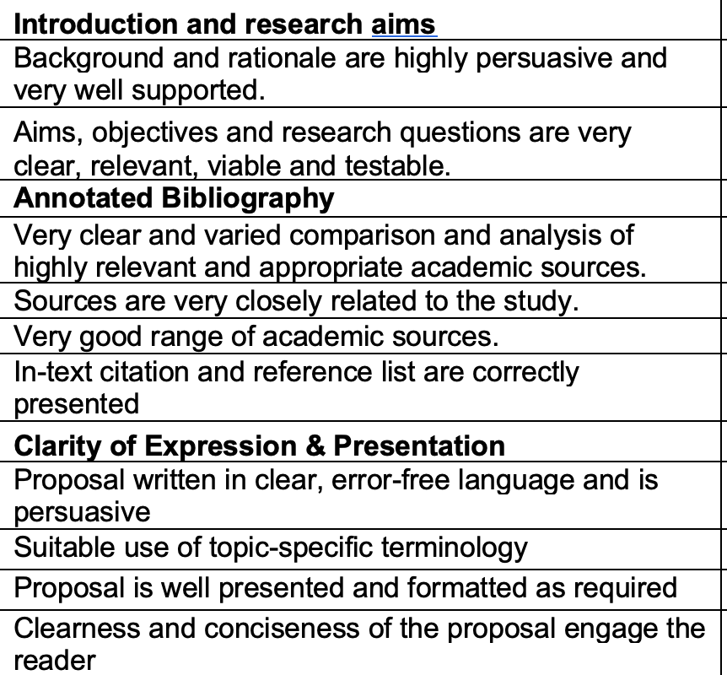
Proposal Marking Criteria

Slide 11
FUTURE LESSONS
In Cycle 1, we will cover all the skills necessary for completing your Research Proposal, e.g.:
Formulating research aims and questions
Finding and describing sources
Referencing
Paraphrasing and summarising

Slide 12

Additional Reading
[On secondary research] Church, R. M. (2001) The Effective Use of Secondary Data, Learning and Motivation, 33(1): 32-45
[On developing a proposal] Thomas, G. (2017) How to Do Your Research Project. London: Sage, Chapter 1

